Slide 1
Containers and Images
AI2C Techs

Slide 2
Lesson Objectives
Understand what containers are and how they differ from traditional virtualization.
Explain the benefits of using containers for application development and deployment.
Identify the key components of container technology, including container engines, images, and registries.
Deploy a simple application using Docker as a practical example of container technology.

Slide 3
Containers

Slide 4
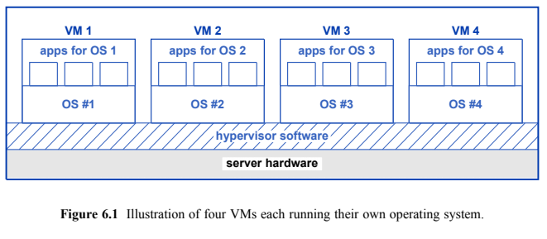
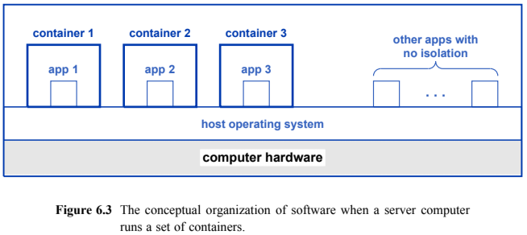
Spot the Difference

Slide 5
VM Overhead
VMs run their own operating system
Many VMs will have the same operating system (Linux, Windows, etc)
Each copy of the OS has a job scheduler, kernel, drivers, etc, etc
How can we eliminate overhead but keep the flexibility of VMs?

Slide 6
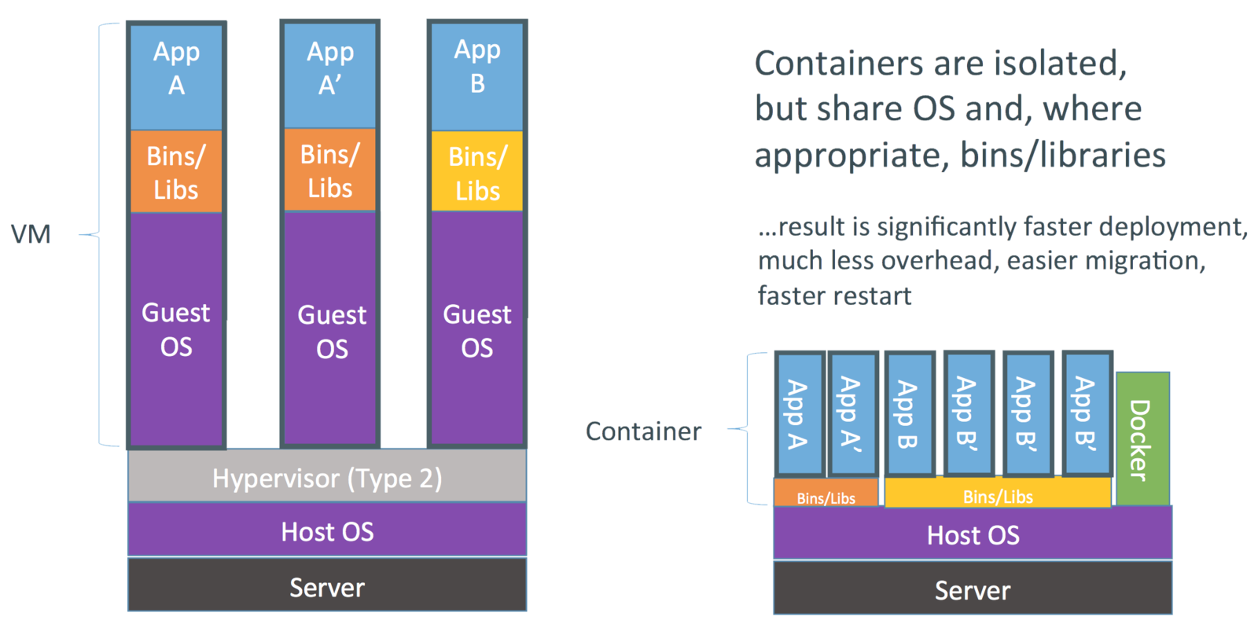
Containers
Surround an “app” in a “container”
The container is the boundaries of that app
The app believes it has a normal OS

Slide 7
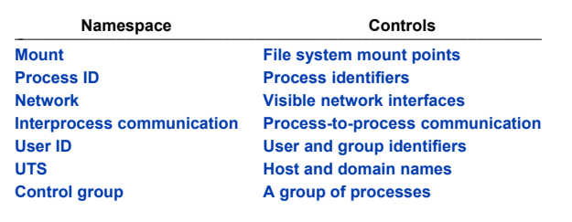
Isolation Mechanisms
Linux has a number of mechanisms to isolate processes from each other
Pre-existing and new concepts for containers

Slide 8
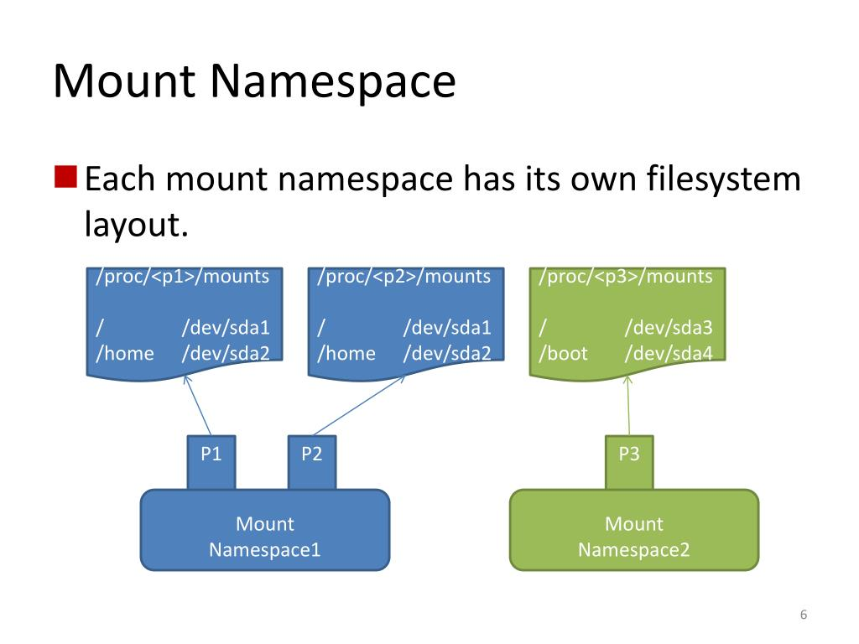
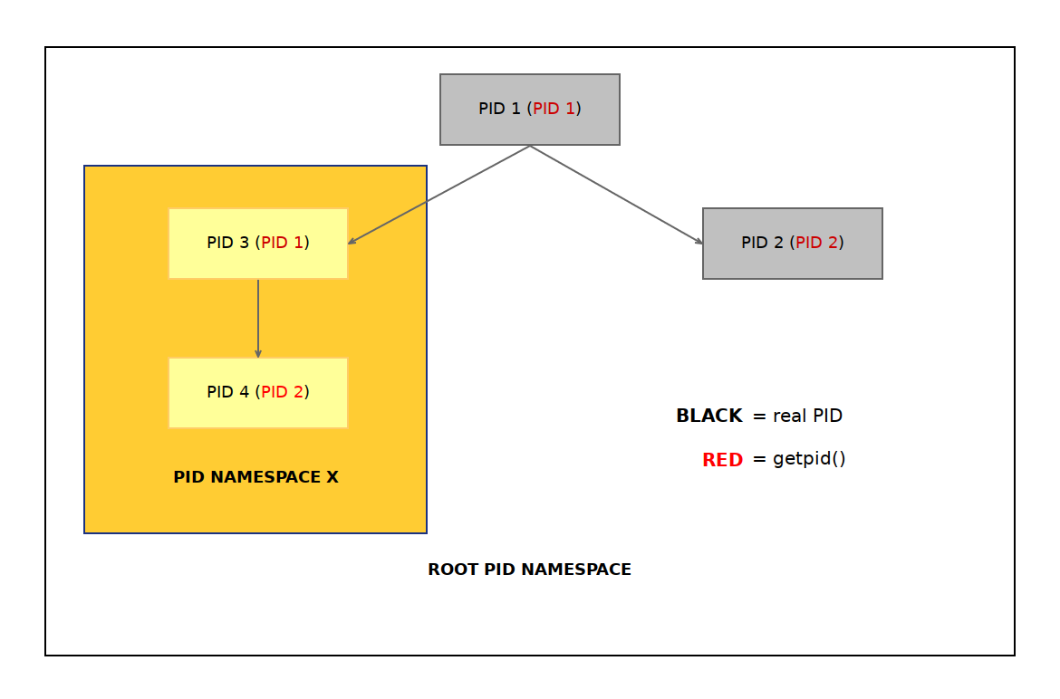
More On Namespaces
Process
Mount

Slide 9
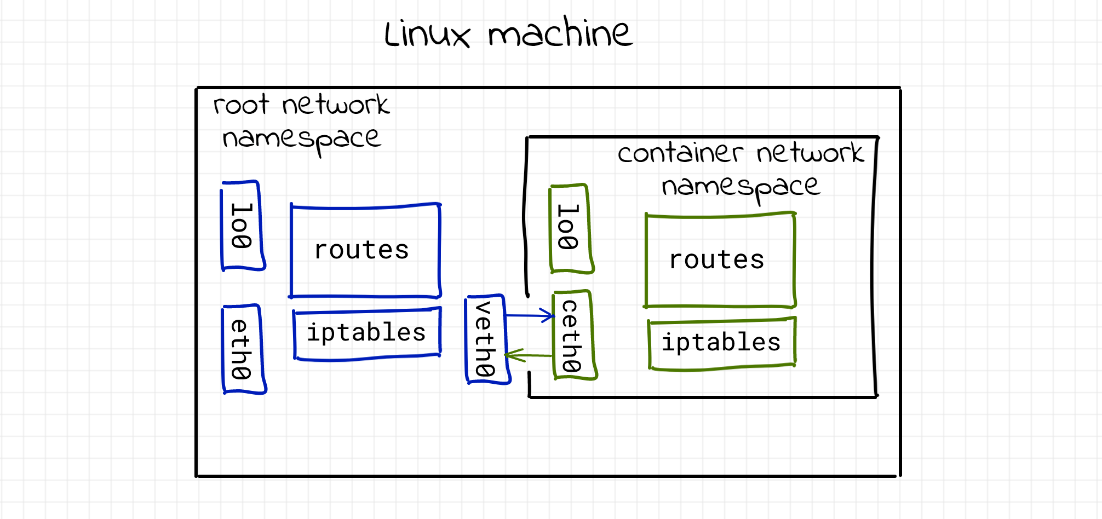
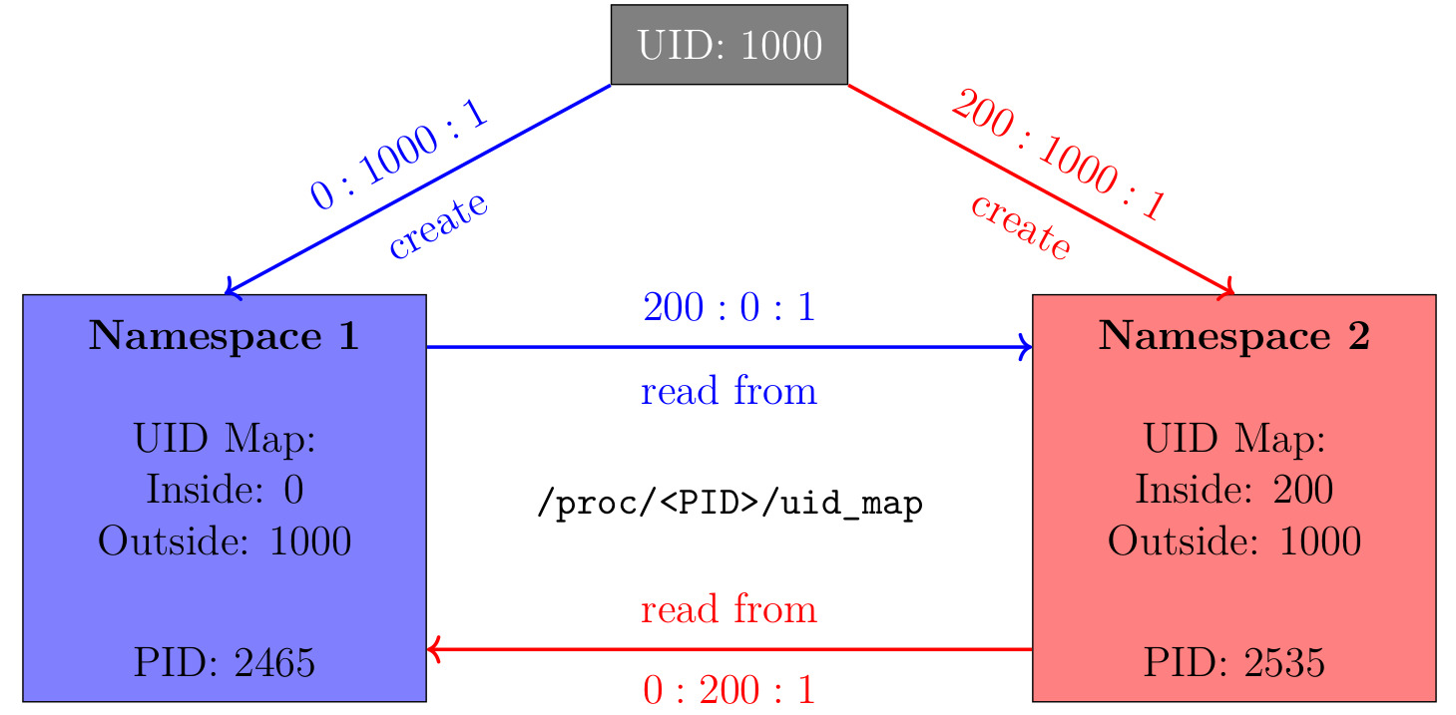
More On Namespaces
Network
User ID

Slide 10
But wait…
Those namespaces look like a lot like overhead…

Slide 11
Other Container Considerations
Apps are built into “images”
Once an image is built, it is immutable
A container is one instantiation of that image
Any changes in a running container are temporary / non-persistent
Therefore… if we built image A, how does container A now compare to container A 3 months from now?

Slide 12
Container Support
Engines, Images, Layers, Registries, Repositories

Slide 13
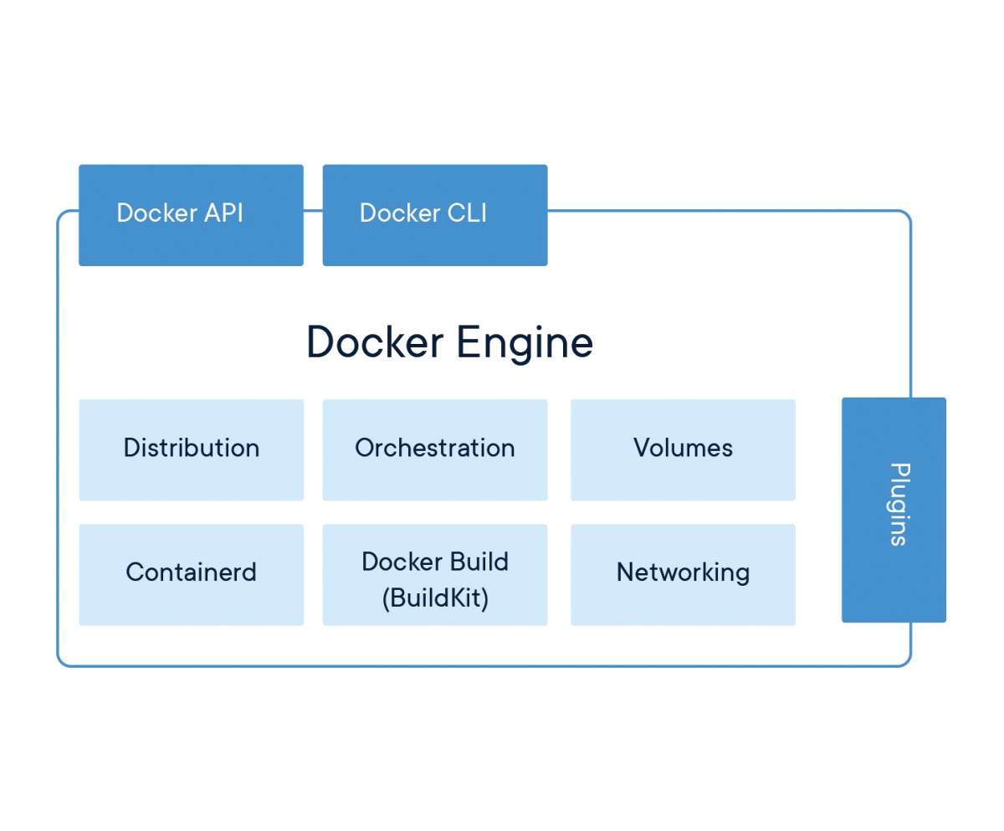
Container Engines
A daemon or process that interfaces between users and containers
dockerd, lxcd
Important role in making establishing namespaces / communication

Slide 14
Examples
lxd
dockerd
containerd
hyper-v

Slide 15
Container Image
A file (typically text or binary) that is used by the engine to start a container
The image is hashed and (optionally) signed to validate the image before running
Images are immutable after creation
Standardizing towards Open Container Initiative format

Slide 16
Onions…
Images are composed of layers
Layers are “stacked” on top of each other
The image specifies how to stack the layers
A layer includes multiple files
A layer may overwrite the contents of an earlier layer
We can hash the layers…

Slide 17
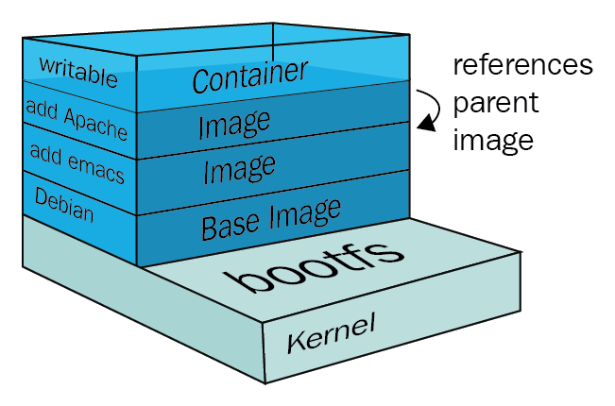
An Example

Slide 18
Repository & Namespaces
Repository – location that hosts container images (and their metadata)
  Images are versioned (remember, immutable) by tag
Namespace – separates groups of repositories

Slide 19
Registry
A location that hosts multiple repositories.

Slide 20
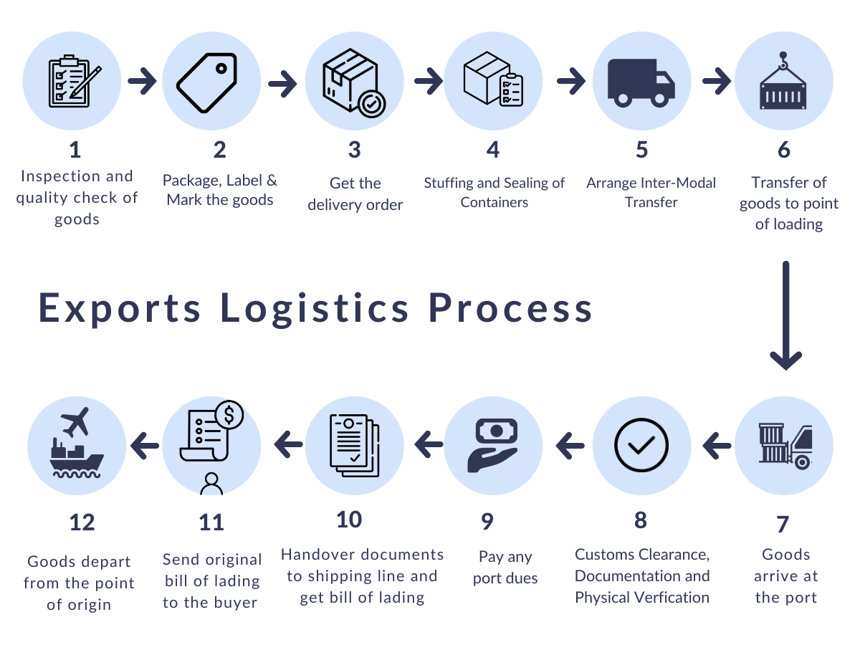
Full Container Process

Slide 21
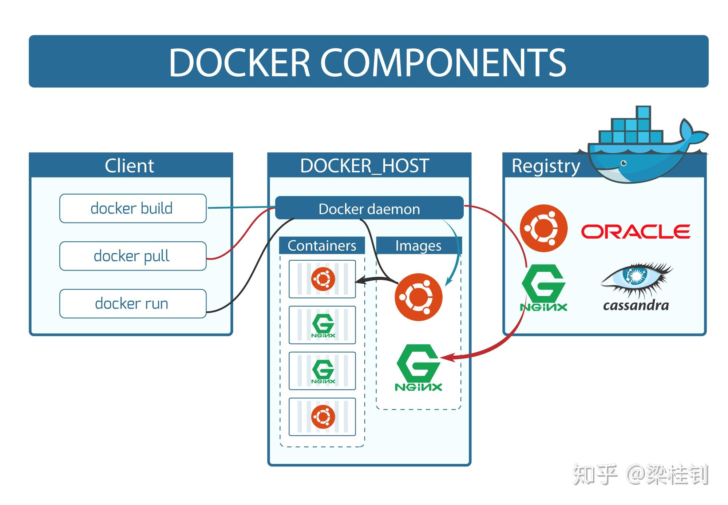
Full Container Process

Slide 22
More About Images

Slide 23
Multi-architecture support
Image tags may include a manifest
Manifest lists which platforms are supported
Docker automatically determines the correct platform

Slide 24
Image Security
Since images are composed of files…
  We can scan the files statically (more about this later)

Slide 25
Docker

Slide 26
Docker Demo

